Slide 1
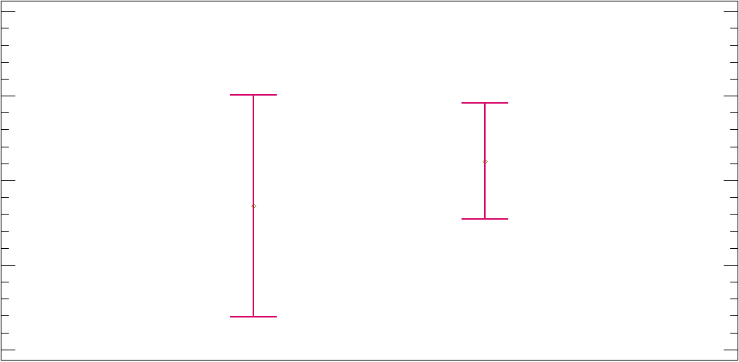
Means & 95% of Fisher´s LSD
16
15
YearsCode
14
13
12
Portugal
Spain
Country

